Slide 1
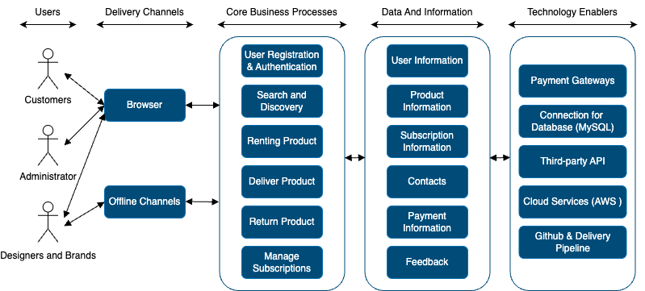
Application: StyleX Type: Application Architecture View: Logical View Style: Layered Architecture Pattern

Slide 2
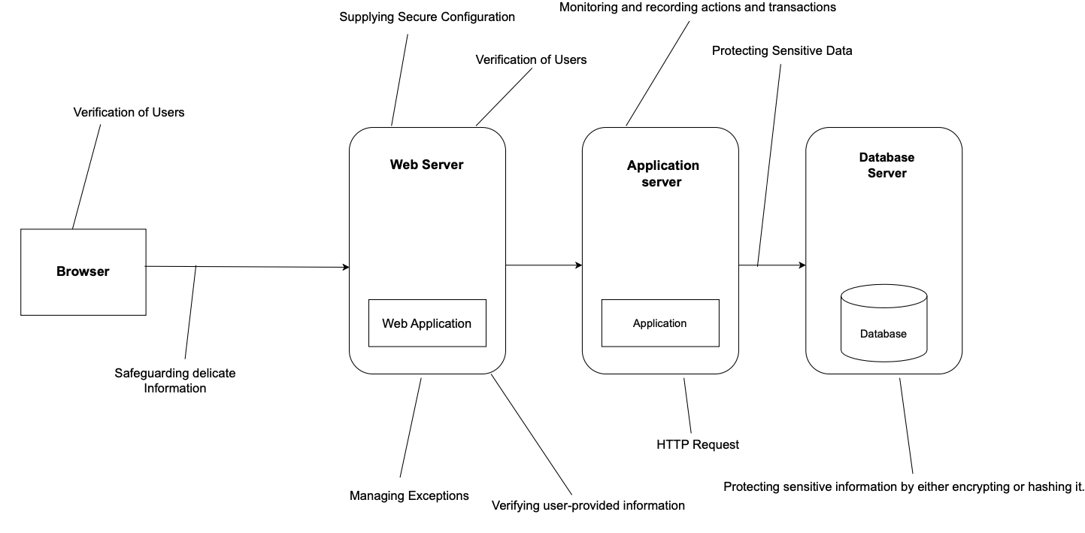
Application: StyleX Type: Application Architecture View: Process View Style: Client-Server Pattern

